Slide 1


Student Details
Name: Gandhamalla Sai Vineeth
AICTE ID: STU64da0d09e77091692011785
Skills build email id: vineeth3094@gmail..com
College name: Institute of Management Studies University Course Campus, Ghaziabad
Internship Domain: Front-End Development from - 24th June to 31st July 2024.

Slide 2
PROJECT TITLE/Problem Statement
Cryptex: Cryptocurrency Dashboard
The rapid fluctuations in cryptocurrency prices require investors and enthusiasts to have access to real-time data to make informed decisions. Traditional financial dashboards often lack real-time updates and user-friendly interfaces tailored for cryptocurrency markets. Cryptex aims to address this gap by providing a comprehensive, interactive, and real-time dashboard for monitoring cryptocurrency prices and market trends, enabling users to stay updated and make timely decisions in the volatile crypto market.

Slide 3
AGENDA
Introduction
Project Overview: Cryptex
Objectives: Creating a crypto dashboard for real-time price updates
Market Analysis
Cryptocurrency Market Trends
Importance of Real-Time Data
Development Process
Technology Stack: HTML, CSS, JavaScript
Design and User Interface
Core Features
Homepage with Key Information
Real-Time Crypto Prices and Market Trends
User Experience and Navigation
Conclusion
Project Outcomes
Future Work

Slide 4
PROJECT OVERVIEW
Cryptex is a comprehensive cryptocurrency trading platform. It allows users to engage in various types of coin transactions, such as Spot Trade, Futures Trade, P2P, Staking, Mining, and Margin Trading.
Key Features:
Real-Time Cryptocurrency Prices: View up-to-date prices for a wide range of cryptocurrencies, ensuring users have the latest market data.
Buy and Sell Cryptocurrencies: Supports buying and selling of popular cryptocurrencies like BTC, ETH, XRP, etc.
Mobile Trading: Users can manage their holdings directly from their mobile devices.
Secure Transactions: Ensures that only users have access to their funds, enhancing security and user confidence.
Trading Experience:
Cryptex offers a diverse trading experience on the Bitcost platform, making it suitable for both novice and experienced traders. Users can perform a variety of transactions, making it a versatile choice for anyone looking to invest or trade in digital assets

Slide 5
WHO ARE THE END USERS of this project?
The end users of the Cryptex platform are primarily Cryptocurrency Investors and Traders. These users are looking for a secure and user-friendly platform to manage their digital assets. The platform is designed for:
Novice Traders:
Individuals new to cryptocurrency trading who need a simple and intuitive platform.
They benefit from educational resources and user-friendly interfaces that make it easier to understand trading concepts.
Experienced Traders:
Individuals with a background in trading who require advanced features and tools.
These users benefit from the diverse trading options, such as Spot Trading, Futures Trading, P2P Trading, Staking, Mining, and Margin Trading.
Institutional Investors:
Larger entities that manage portfolios of digital assets.
They seek platforms with high security, liquidity, and efficient transaction processing.

Slide 6
YOUR SOLUTION AND ITS VALUE PROPOSITION
Value Proposition of Cryptex
Ease of Use: Cryptex is designed to be the easiest, safest, and fastest way to buy and sell crypto assets. This focus on user experience ensures that even beginners can navigate and trade effectively on the platform.
Diverse Trading Options:
Spot Trade: Immediate purchase or sale of cryptocurrencies at current market prices.
Futures Trade: Contractual agreement to buy or sell a cryptocurrency at a predetermined price at a specific time in the future.
P2P (Peer-to-Peer): Direct trading between users, allowing them to negotiate prices and terms.
Staking: Users can earn rewards by holding and supporting specific cryptocurrencies.
Mining: Participate in cryptocurrency mining to earn coins.
Margin Trading: Trade with borrowed funds to increase potential returns.
Comprehensive Market Coverage: The platform covers different segments such as DeFi, BSC, NFT, Metaverse, Polkadot, Solana, Opensea, and Makersplace​

Slide 7
How did you customize the project and make it your own
Navigation Bar Enhancements:
Streamlined the navigation bar for better user experience and added a Peer-to-Peer (P2P) Deposit section for direct crypto transactions between users.
Trends Section Expansion:
Added new trends such as NFTs, DeFi, Metaverse, and Solana to reflect the latest market interests.
Updated Cryptocurrency Values:
Integrated real-time updates for crypto values and percentages to ensure users have access to the latest market data.
Extended Coin Categories:
Enhanced tab navigation with new categories like Alt Coins and AI Coins, providing users with broader investment options.
Revised About Section:
Rewrote the "What is Cryptex" section to better highlight the platform's features, such as ease of use, security, and diverse trading options.
Updated Footer Information:
Added contact details, including phone number, email, and address, to improve accessibility and user support.
Custom Copyright:
Updated the copyright statement to reflect the current year and details of the owner

Slide 8
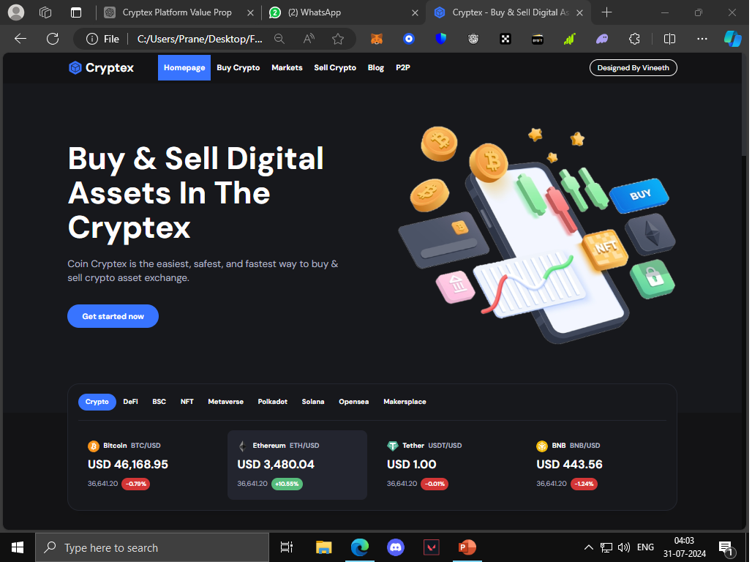
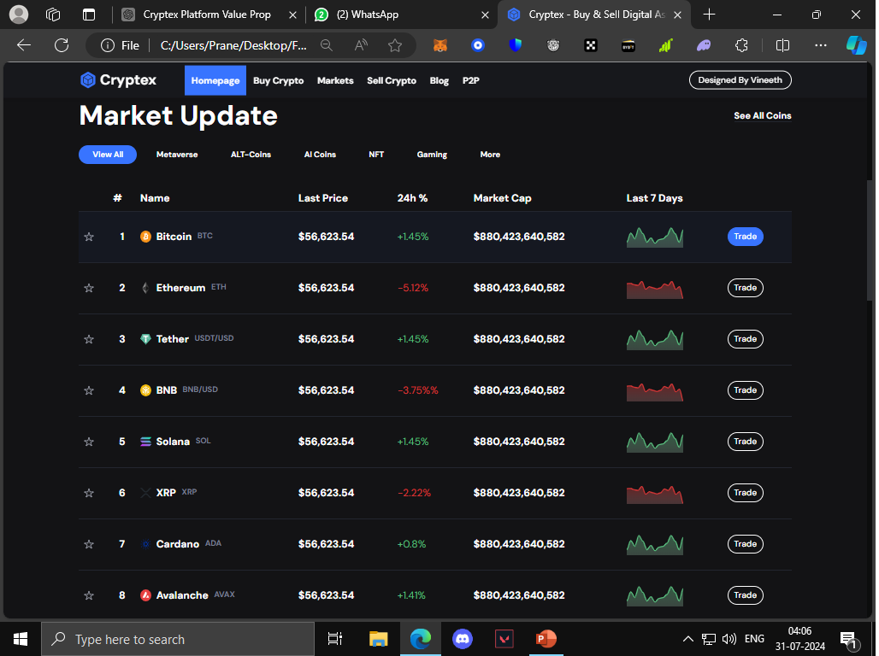
Results
Market Update Tab
Cryptex Dashboard

Slide 9
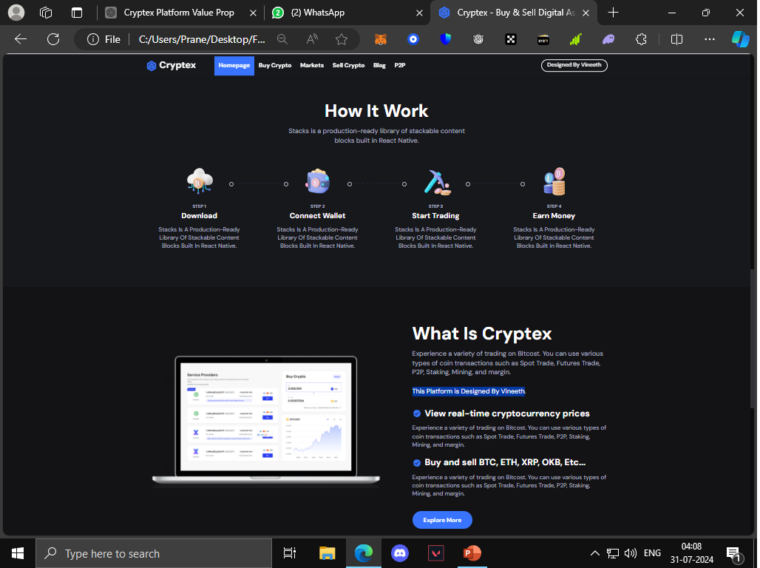
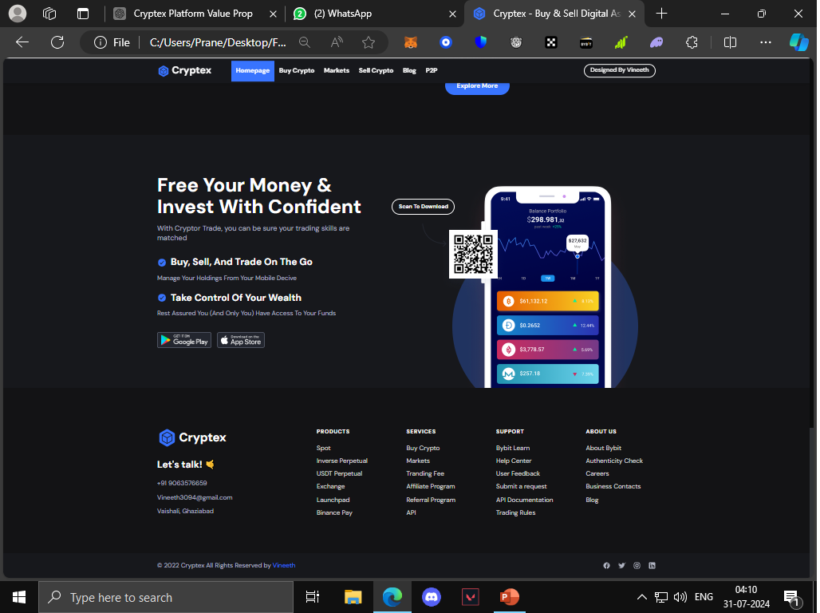
Results
About Section
Footer Information

Slide 10
links
Github Repository Link: https://github.com/Vineeth3094/Cryptex.git

